Slide 1
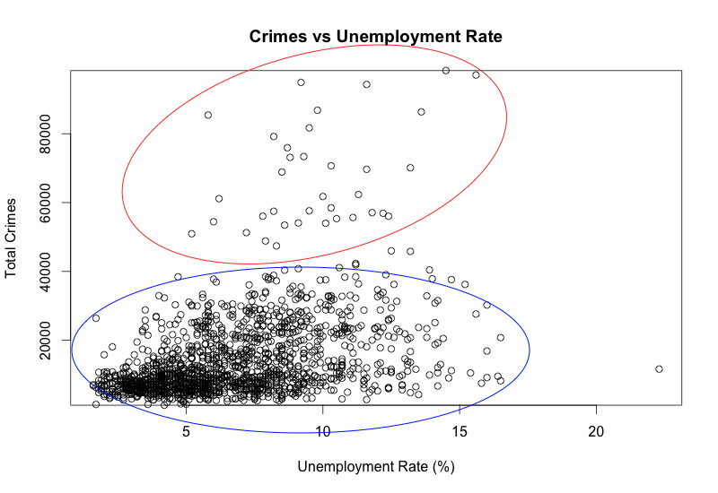
Extensions
Clusters?

Slide 2
Extensions
What to do with crime type data?
Case Studies?
LAD_name | Year | Crime_type | Count
Bristol | 2013 | Vehicle crime | 3264
Bristol | 2016 | Robbery | 28
Bristol | 2016 | Theft from the person | 48
Bristol | 2013 | Criminal damage and arson | 4761
Bristol | 2013 | Violent crime | 2268
Bristol | 2016 | Burglary | 389
Bristol | 2011 | Other crime | 7804
Bristol | 2011 | Drugs | 551
Bristol | 2011 | Robbery | 550
Bristol | 2015 | Bicycle theft | 1572
Bristol | 2012 | Anti-social behaviour | 14347
Bristol | 2015 | Public order | 3113
Bristol | 2014 | Other theft | 5224
Bristol | 2011 | Burglary | 4718

Slide 3
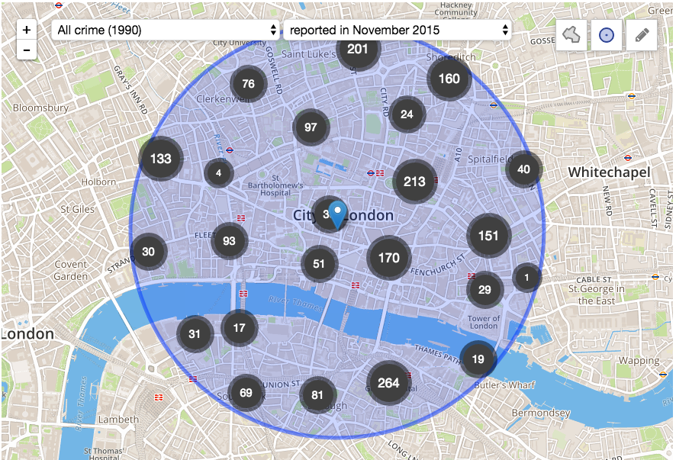
Add more features to maps
Extensions
Look into other platforms (OpenStreetMaps)

Slide 4
Expand to other Datasets
Extensions
US Police Data Initiative
“21 police departments have committed to release a combined total of 101 data sets… The types of data include uses of force, police pedestrian and vehicle stops, officer involved shootings…” – May, 2015
Total is now 53 committed police departments, and counting:

